Slide 1
CHALLENGES
OF
ISLAMIC BANKING
IN
TANZANIA
Rashid H.H. Rashid
Head, KCB Sahl Banking Tanzania
2018

Slide 2
Table of Contents:
What is KCB Sahl Bank
KCB Group at a glance
KCB Bank Tanzania & KCB Sahl banking Tanzania
Challenges of KCB Islamic Banking
Operational challenges
Market penetration challenges

Slide 3
KCB Islamic Banking Window

Slide 4
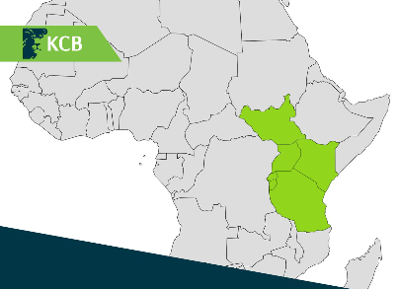
KCB BANK GROUP AT A GLANCE
Tanzania
Kenya
Uganda
Rwanda
Burundi
South Sudan
Started in 1896,
One system platform
The only regional bank with an Islamic Banking window, currently:
Kenya & Tanzania
Largest regional bank
Asset over USD 6.5Billion
TZS 14.6 Trillion
Profit After Tax USD 215 Million
TZS 488 Billion

Slide 5
KCB BANK TANZANIA LIMITED
Started in 1997
14 Branches in total:
D.S.M (8),
Morogoro (1),
Arusha (2),
Moshi (1),
Mwanza (1) &
Zanzibar (1).
Islamic Banking window 2008
Offer Islamic banking through all branches
2 Full shariah branches:
Zanzibar
Lumumba

Slide 6
CHALLENGES
OF
ISLAMIC BANKING
IN
TANZANIA

Slide 7
CHALLENGES OF ISLAMIC BANKING IN TANZANIA
Operational challenges:
Shortage of skilled workforce
Lack of formal regulatory framework;
Lack of shariah compliant money market/capital markets
Double taxation
Lack of Shariah compliant Insurance, i.e Takaful

Slide 8
CHALLENGES OF ISLAMIC BANKING IN TANZANIA…….
Market penetration challenges:
Imbedded conventional banking culture
Limited knowledge & awareness about Islamic Banking
Wrong perception in the market:
Islamic Banking is for Muslims only (not true)
Limited banking capacity/options (not true)

Slide 9
KCB ISLAMIC BANKING (SAHL BANKING)
For any enquiries please Contact:
SahlBanking@tz.kcbbankgroup.com
+255 22 2160330

